Slide 1
OpenGL Project Demo 海浪粒子系統模擬
組員
呂和軒
王家均
簡嘉均

Slide 2
Outline
Wave Simulation
Model Loading
Particle System
Expected Result
Our Result
Demo
Conclusion

Slide 3
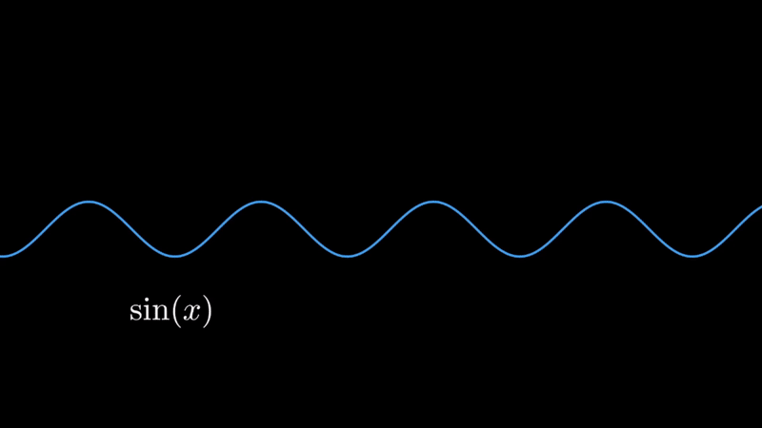
Wave Simulation
Simulating the height field of wave surface
Control the shape of wave with wavenumber, angular frequency, phase
Notes:
模擬海浪最重要的一點就是產生出海浪的波型，這要怎麼做到呢?
我們先從簡單的開始，下面有一個 sine function，加上變數 t 後就變成了會前進的 sine 波，我們可以加入 波長 k 、角頻率 $\omega$、相位、常數 A 來改變他的波型

Slide 4
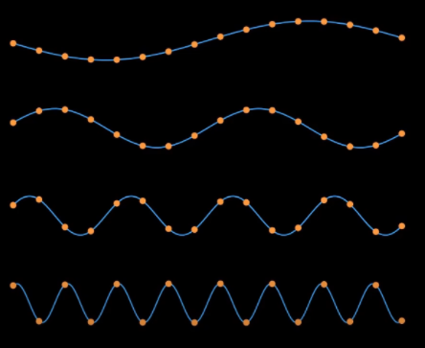
Wave Simulation
Sum multiple sine wave with different parameter to form Ocean Wave
How to determine the wavenumber, angular frequency, phase for each wave?
Notes:
既然我們可以擁有各種形狀的波，模擬複雜的海浪波一個很直覺的方法就是用很多個不同參數的波線性疊加起來，形成海浪的波型
但是這又遇到了一個問題要如何決定每個波不同的參數是多少呢? 我們怎麼知道選定哪些參數的波在疊加後可以形成逼真的海浪波?

Slide 5
Wave Simulation
Use Statistical model as the solution
Fourier Transform and Ocean-Wave Spectrum
Notes:
解決方法就是裡用統計模型 Statistical model，
這個方法會使用到快速傅立葉轉換 fast Fourier transform, FFT** 和 **海洋頻譜 Oceanographic Spectrum

Slide 6
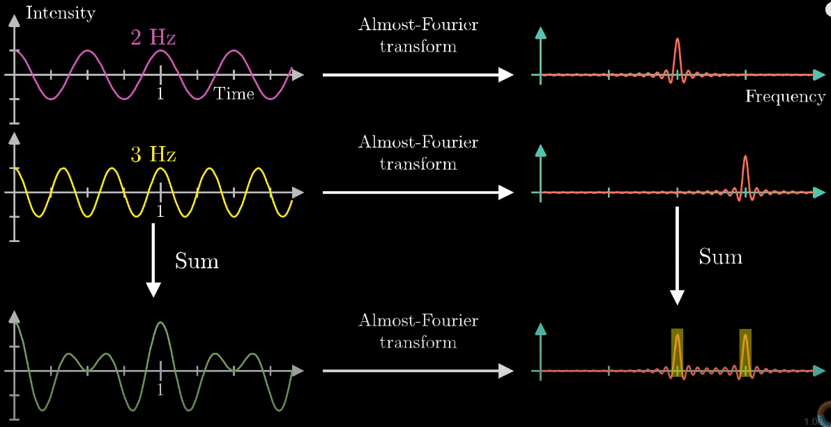
Wave Simulation
Notes:
我們知道傅立葉轉換能夠把資料從時域波形轉換到頻譜，頻譜所呈現的是，各種頻率的波重疊而成的合成波中，某一頻率上能量集中的程度，簡單的講就是在一個複雜的波形裡，哪些頻率的波佔了哪些多少比例的感覺
而 inverse Fourier transform 可以將頻譜轉回時域波形，那我們能否有一個海浪的頻譜，將海浪的頻譜經過 inverse Fourier transform 後得到海浪的波形?

Slide 7
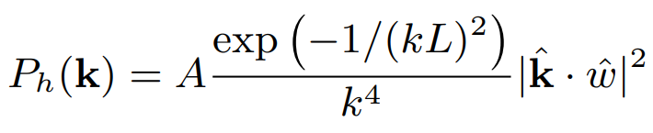
Wave Simulation
We can use Inverse Fourier Transform to get the Wave of Ocean Spectrum
We use Phillips spectrum
There are other spectrums
Pierson-Moskowitz
JONSWAP
Notes:
答案是可以，這就是為什麼這方法叫做統計模型，因為他使用已經測量分析好的頻譜去生成海浪的波形
我們的 project 使用的是 Phillips spectrum，此頻譜描述的是因為風而生成的海浪的波形，k 是波長，也代表波的行進方向， omega 是風的方向
也有許多不同的頻譜，每個頻譜描述的波形，公式參數，假設的海浪形成原因都不一樣

Slide 8
Wave Simulation
Use Inverse Fourier Transform to Compute Height map and Normal map at each frame
Put Height map and Normal map into shader to draw wave and lighting
Notes:
所以模擬海浪波型的作法就是每一個 frame 都用 Inverse Fourier Transform 去計算 vertex 的 height map 和 normal map，
再從 shader 計算 lighting

Slide 9
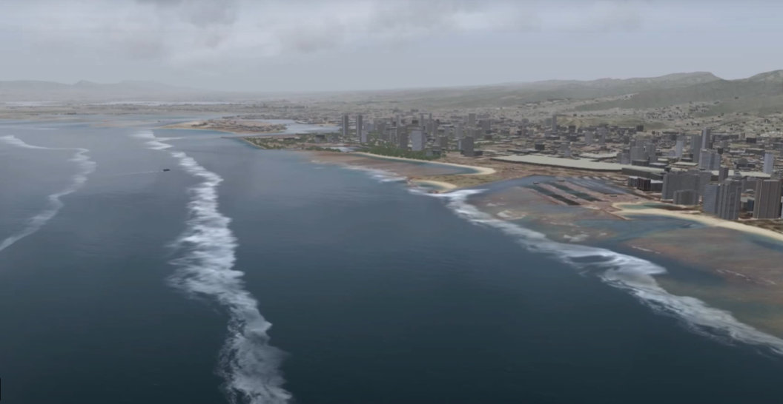
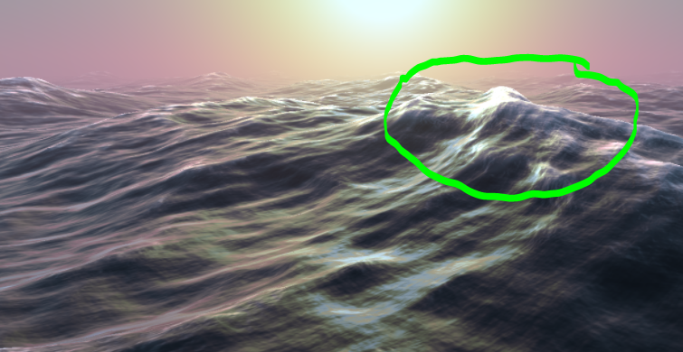
Wave Simulation
There are so much things we can do
Spray on the top of wave
Tile the wave to a big ocean
Breaking weave on shoreline
And so on ……

Slide 10
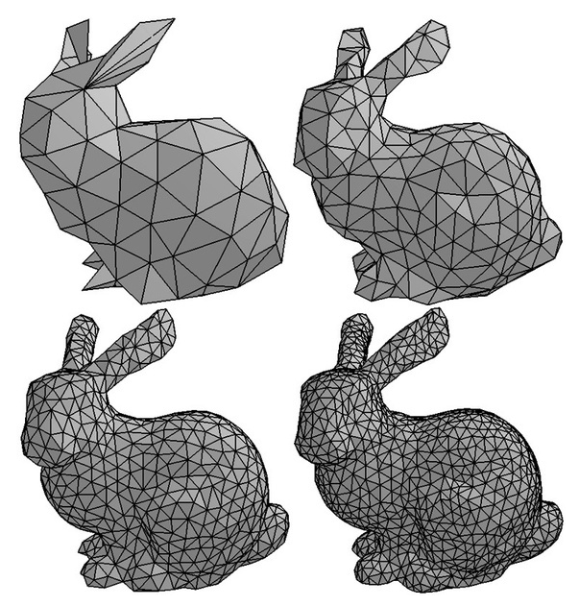
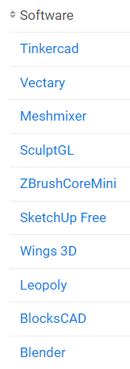
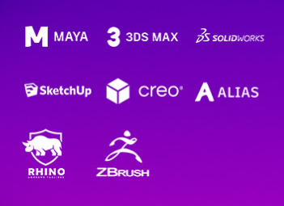
Model Loading
Realistic Model Software : Blender, 3DS Max, Maya

Slide 11
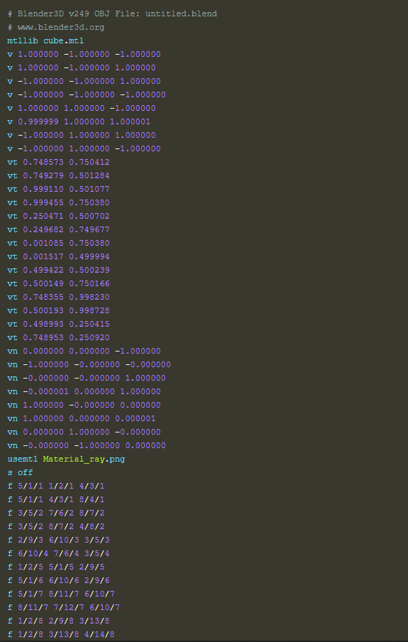
Model Loading - OBJ
Model Type File ex. Obj檔,STL檔(右為OBJ)
Vertex Position
Normal
Texture Coordination
Face
Texture itself or MTL檔輔助

Slide 12
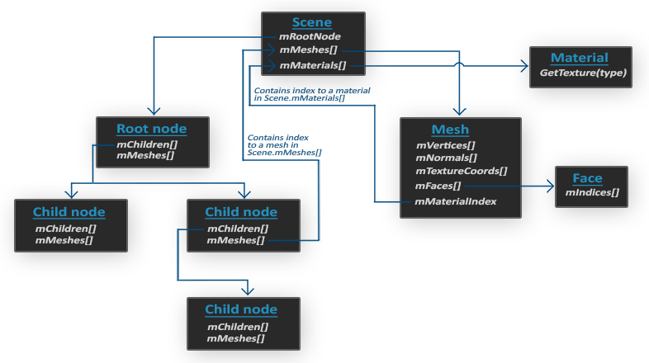
Model Loading -Assimp
Assimp
Open Asset Import Library
把3D model轉成此資料結構
We need….
轉成OpenGL 格式

Slide 13
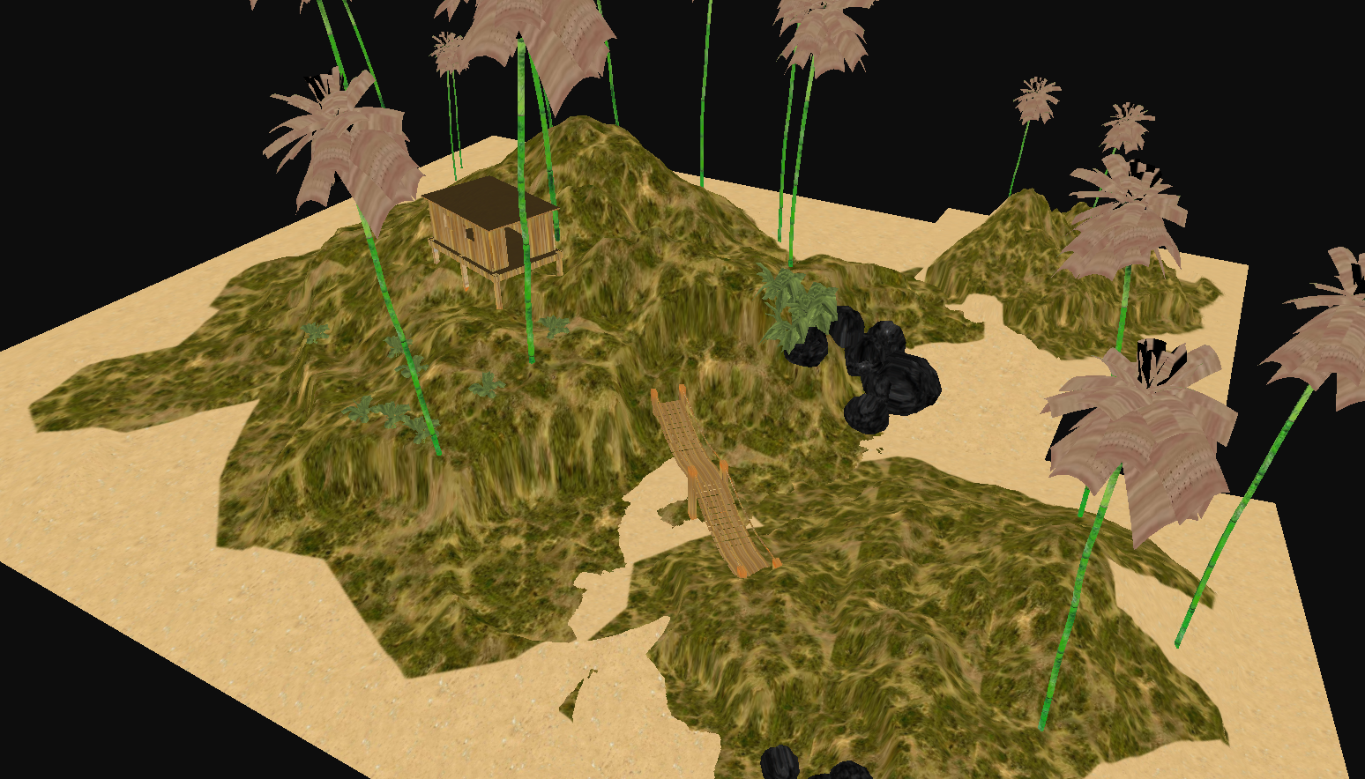

Slide 14
Particle System
Particle System
Two main object class
Particle
Particle manager
Self-define parameter
Position, Velocity, Color, Lifespan …
Design parameter for target effect

Slide 15
Particle System
Particle Render
If use CPU : can’t handle the massive number of particle render in real time
Adapt to GPU
Use Transform Feedback
Geometry Shader
Emit Part
Update Part
Draw Part

Slide 16
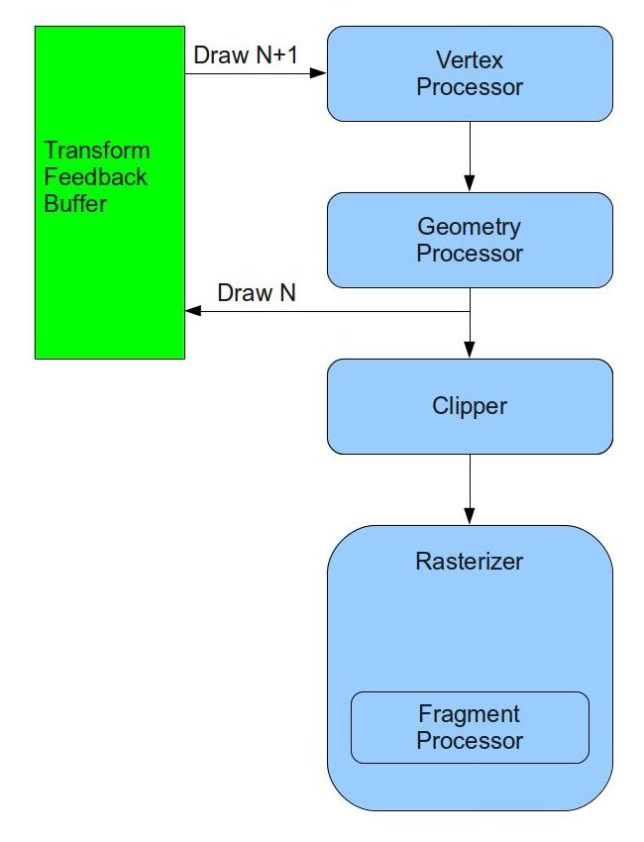
Particle System
Transform Feedback
Reduce updating time
No need to rebind buffer to GPU
Two TF Buffer for update and draw in turn

Slide 17
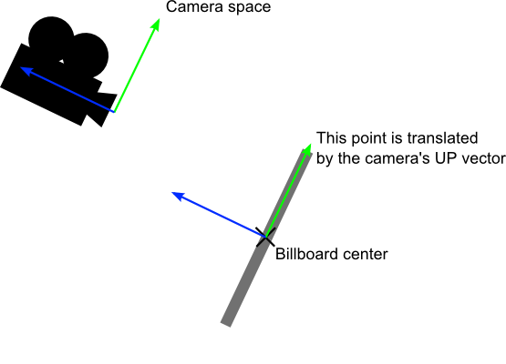
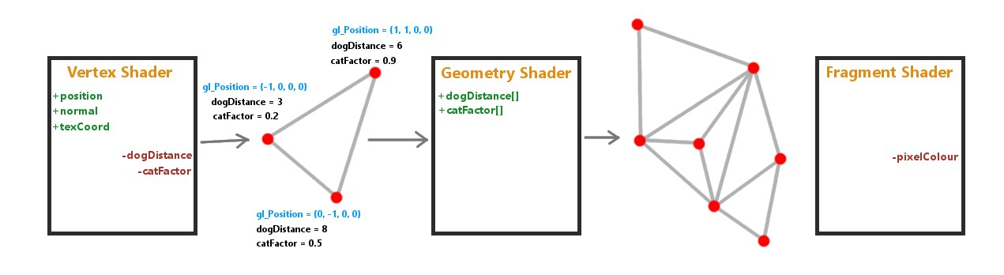
Particle System
Geometry Shader
Generate particle vertex
Generate particle shape – billboard

Slide 18
Particle System
Emit Part
One or more Base emit particle as input
Use Geometry shader to emit (one frame to generate 80 particles)
New particle information load to TF buffer
Random initial parameter for particle effect

Slide 19
Particle System
Update Part
Update new and old particles
Use Geometry shader to check lifespan for output or not
Describe move rule and effect design
Loading to TF buffer

Slide 20
Particle System
Draw Part
Render all particles in TF buffer
Use geometry shader to draw billboard and control size
Texture sample for color and alpha blend

Slide 21
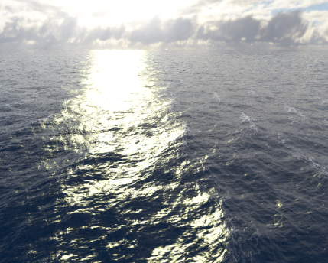
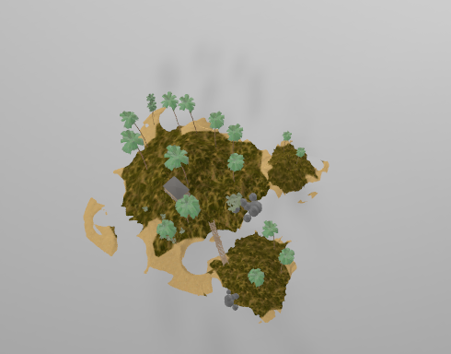
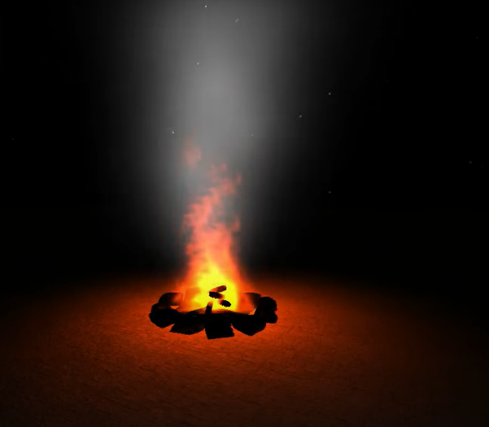
Expected results
Realistic Ocean & Island with Particle effect
Ocean surface wave & lighting
Island model construct
Particle Fire effect
More advanced special effect base on this if we can.

Slide 22

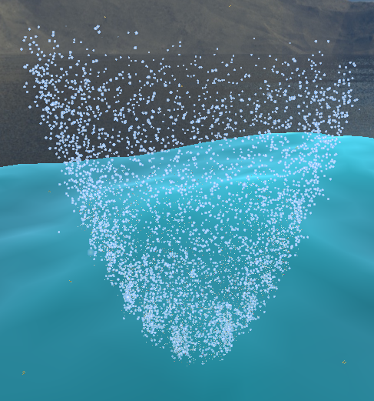
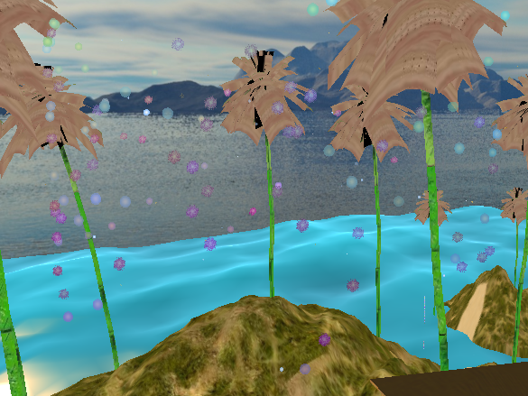
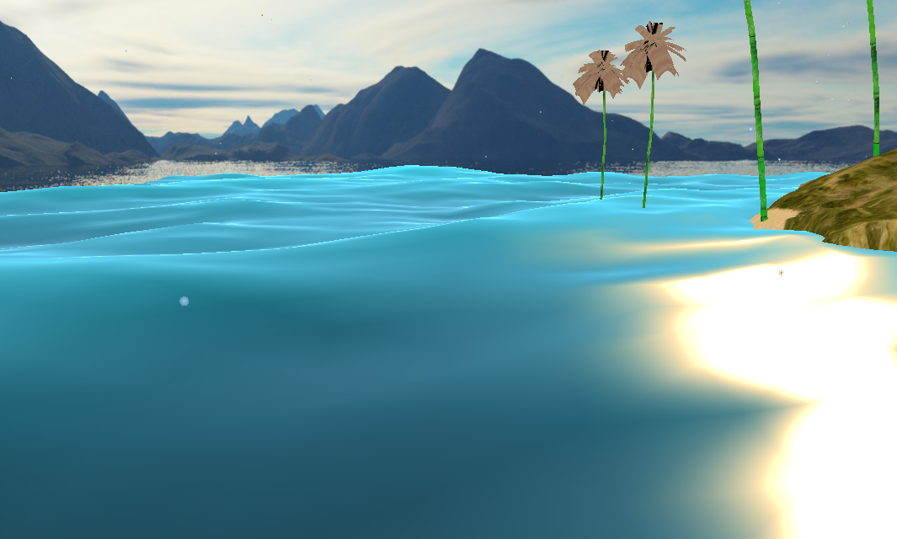
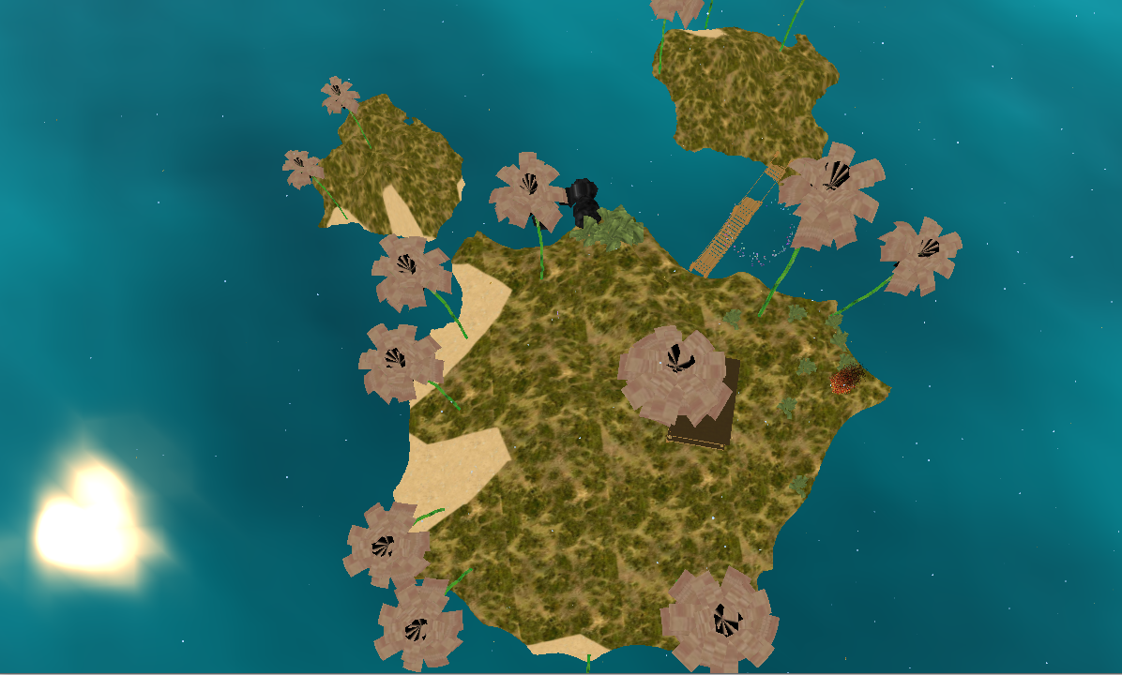
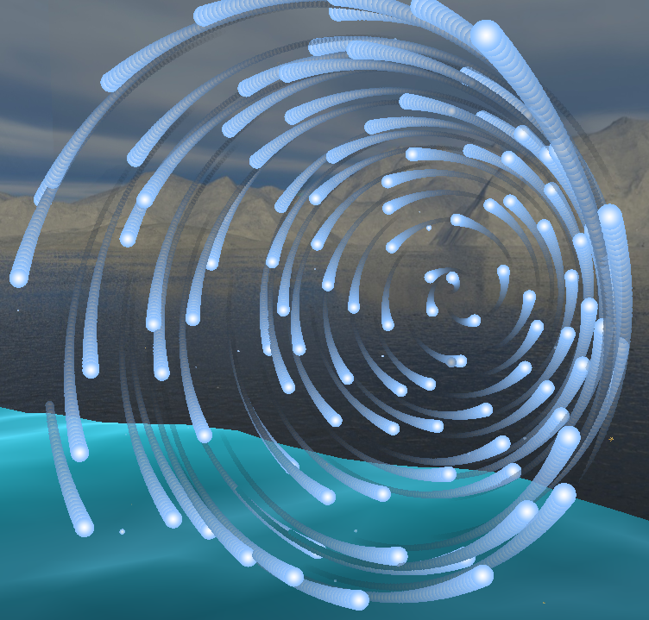
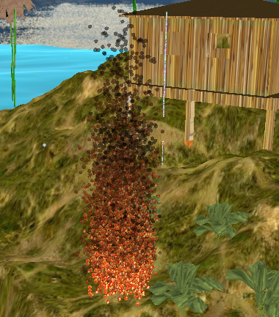
Our results
Ocean Simulation
Island model construct
Particle effect Fire, Tornado, Firework, Snow, Tail

Slide 23
Demo

Slide 24
Conclusion
Learn more techniques about OpenGL
Learn how to simulate wave with Fourier transform
Learn how to load model to OpenGL
Adapt particle system to GPU improve efficiency
Base on the particle system we could make more special effects

